Slide 1
National monitoring of the background impregnation of pesticides in ambient air in France
Aude Bourin, IMT Nord Europe/LCSQA
Caroline Marchand and Fabrice Marlière, INERIS/LCSQA

Slide 2



Review of French works on pesticides
90’s: wonderings about transfer of pesticides in air
Since 2000: developments of sampling and analysis methods
French standardisation in 2007 (XP X43-058 & 059)
2001: beginning of measurement campaigns by local networks
PhytAtmo database which aggregates about 7000 samples
176 sites : [urban/rural] [background/proximity] [permanent/spot]
321 active substances (AS) / all agricultural activities
Number of sampling points

Slide 3



National exploratory measurement campaign on pesticides (CNEP) in ambient air - 2018-2019
Goals
  first national and harmonised inventory of pesticides levels in ambient air all over France, in a synchronized way and according to a common protocol
  To study influence factors on sampling strategy to help to define the design of pesticides periodic monitoring of on a national scale
French Ministry of Environment
French National Reference Laboratory for air quality monitoring
Choice of measurement sites
Sampling duration and frequency
Analysis methods
French local air quality monitoring networks
French National Agency of Sanitary Safety
Link to the report :https://www.lcsqa.org/fr/rapport/resultats-de-la-campagne-nationale-exploratoire-de-mesure-des-residus-de-pesticides-dans

Slide 4
Overview of the CNEP campaign
Duration of the campaign: 1 year from June 2018 - June 2019
Where: 50 stations working with local networks (DROM and mainland)
More than 1800 samples analysed by a common analytical lab with high-performance quantitation limits (national laboratory intercomparisons 2015 and 2022)
75 studied substances (insecticides, fungicides et herbicides)
  72 semi-volatiles
  3 polar
List of the substances acquired by a selection process

Slide 5
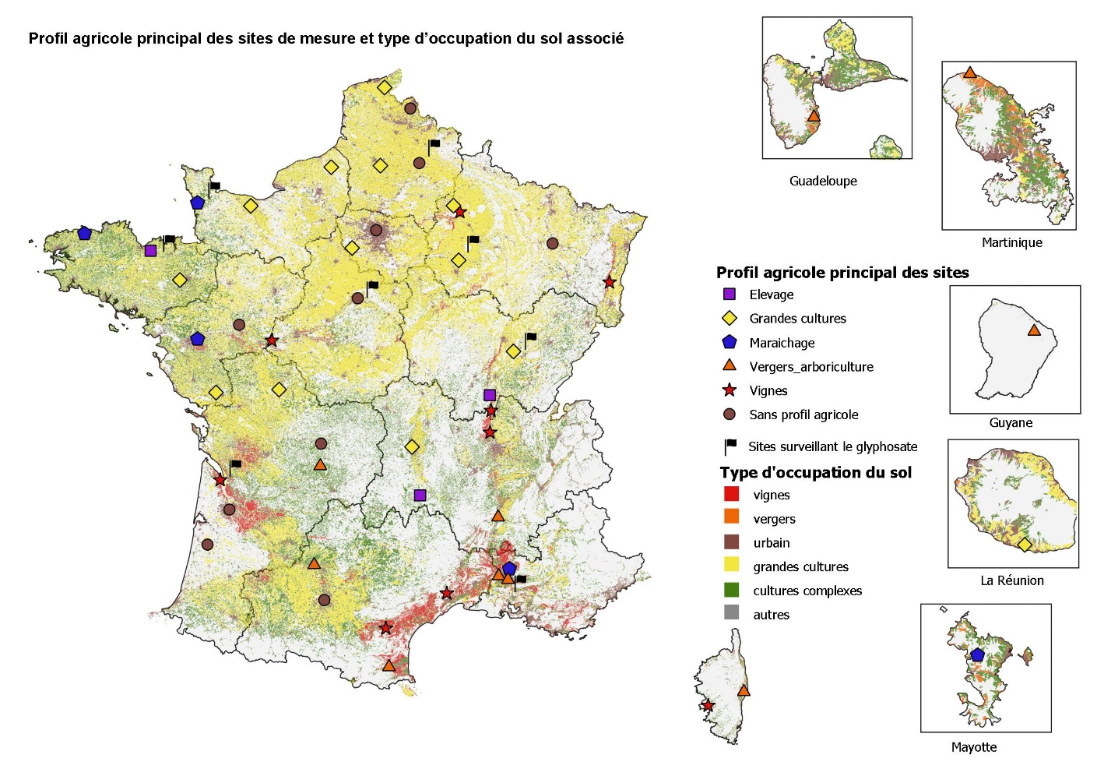
Spatial sampling strategy
located out of the proximity or direct influence of a single crop
Depending on residential areas:
  50% of urban/peri-urban sites
  50% of rural sites
Depending on
major agricultural activities:
  26% of field crop sites,
  18% of wine-growing sites,
  20% of arboricultural sites,
  10% of market-gardening sites
  6% of livestock sites
  20% of sites with no major agricultural activity
1 to 6 sites per region
France
Main agricultural activity of sites
Livestock
Field crops
Market gardening
Arboriculture
Wine-growing
No major culture
Glyphosate monitoring
Type of land use
Vineyards
Orchards
Urban
Field crops
Complex crops
Others
  50 sampling sites distributed all over France (mainland + overseas (DROM))

Slide 6
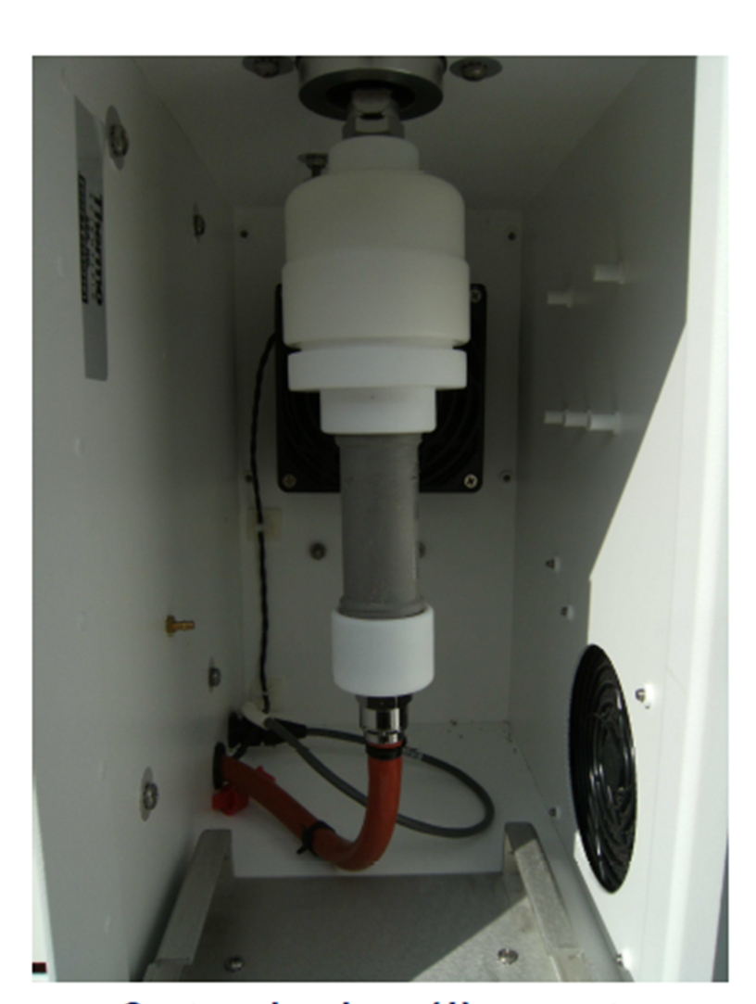
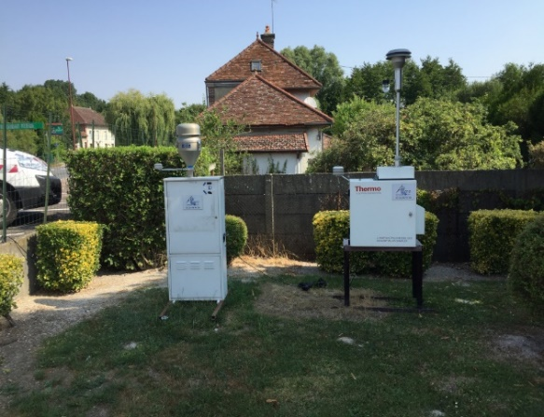
Harmonised sampling protocol and temporal sampling strategy
2 pre-campaign were done to test the influence
  Type of active sampling techniques : low/high volume samplers
  Fraction of PM
  Type of sampler and the use of XAD-2 resin
  Analytical laboratory techniques (LC-MS/MS ESI+ or GCMS/MS)
  Gas/particle phase: global quantification or separate analysis
Recommendations
Partisol or DAH80 with PM₁₀ cut-off
One unique analytical lab
Sampling frequency : 1 month to 1 week
Sampling duration : 2 to 7 days
List of metadata to be provided (met parameters)

Slide 7
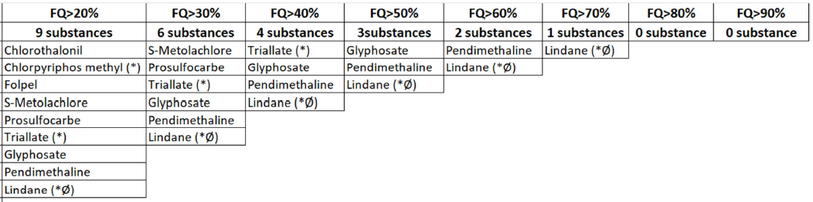
CNEP results
Quantification rate

Slide 8
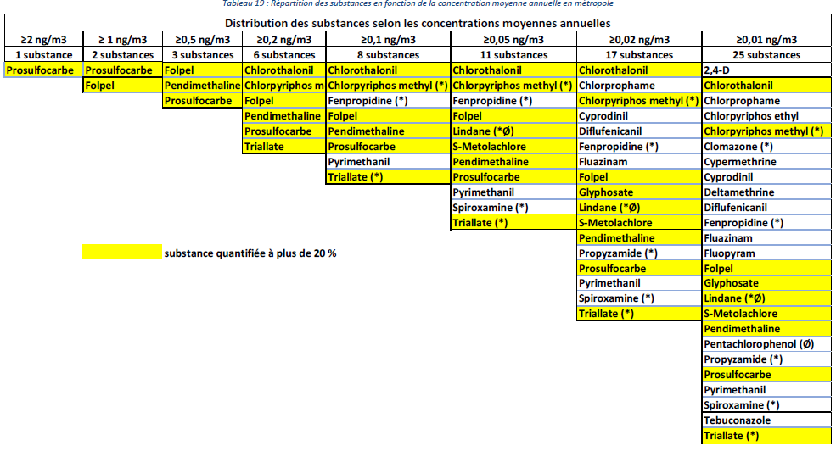
CNEP results
Annual means

Slide 9
Design of a long-term national monitoring 2021 - feedback from CNEP
Goals
  Periodic update of the national « photography » of the CNEP
  Evolution of concentrations over years
Measurement strategy
  Substances : CNEP (75 substances : 72 semi-volatiles, 3 polars)
  Measurement methods: CNEP
  Measurement frequency:
    semi-volatiles: between 18 and 26 weekly samplings per year
    polars: 40 samplings of 48h per year

Slide 10

Design of a long-term national monitoring - feedback from CNEP
Site selection for semi-volatile substances
  1 site per region : 18 sites
  a minimun number of inhabitants within 5km : >20 000 in mainland
  distance from sampling point to 1st plot: > 200m (min 150m )
  agricultural profiles : field crops, viticulture, arboriculture, market gardening (no livestock)
Notes:
For the site selection, the following criteria have been established :
1 site per region to have a spatial representativeness
a minimum number of residents within a 5 km radius of the site to be representative of a living area
a minimum distance from the sampling point to the first plot to be representative of a background exposure level
A distribution among different agricultural profiles to meet the recommendations made
representative of an urban/peri-urban living area ➔ 18 sites

Slide 11
First overview of the results
29 substances are not detected
46 substances are detected and quantified
Highest FQ : glyphosate (75%), lindane (62%), metolachlor (47%), pendimethalin (74%), prosulfocarb (37%) and triallate (43%) -- consistent with CNEP results
Highest concentration (>5 ng/m3) : deltamethrin, folpel, metolachlor, pendimethalin, prosulfocarb and triallate -- consistent with CNEP results
Consolidation of these results in progress
Detailed comparative study with the data obtained during the CNEP 2018-2019 (LCSQA report in 2023)

Slide 12
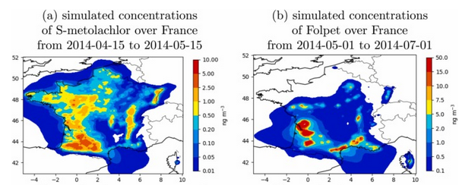
Air pollution models for the dispersion of pesticides
a CHIMERE version accounting for pesticide volatilization from soil and crops
Application of the model for two pesticides
Couvidat et al., 2022 https://doi.org/10.1016/j.jhazmat.2021.12749
Difficulties : coupling spatiotemporal data of pesticide application to a model of pesticide volatilization from soil and canopy

Slide 13
Conclusions
National strategy adopted based on feedback from the CNEP
Data from the long-term monitoring since 2021 : comparative study, modelling
Laboratory intercomparison at the national scale
Need to make some clarifications and methodological additions through the revision of the NF XP X 43-059 standard

Slide 14
Thanks for your attention
Anses contact : fabrizio.botta@anses.fr
Local network contact: emmanuelle.drab-sommesous@atmo-grandest.eu, colin@ligair.fr, ssocquet@atmo-aura.fr
LCSQA/Ineris contact : fabrice.marliere@ineris.fr, caroline.marchand@ineris.fr

